Slide 1

SwagLabs Testing
A Comprehensive Overview of Manual and Automation Testing Strategies

Slide 2






Team Members
Ahmed Khairallah
Ahmed Osama
Rashad Morgan
Salma Farag
Shimaa Sameh
Mohamed Hussien

Slide 3
Introduction
Swag Labs is an e-commerce platform. This testing project assessed usability, functionality, and readiness for deployment

Slide 4
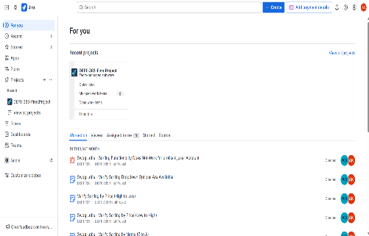
01
Manual Testing

Slide 5
Goals
1 . Introduction
Ensure that the user interface is intuitive, responsive, and provides a smooth user experience across all core functionalities such as browsing, logging in, and checking out.
2. Functionality
Validate that all features perform as expected under various scenarios, including product listing, adding/removing items, user authentication, and sorting products.
3 . Readiness for Deployment
Assess the system’s overall stability and reliability through manual and automated testing to confirm it is ready for production with minimal risk of critical failures.

Slide 6
Planning
Scope
Dates
Order History and Search Products—were out of scope for testing and reported to Eng. Eman, the Product Owner.
Manual Testing : 8 April 2025
Automation Testing : 12 April 2025
Final Submission
Final delivery deadline For Project Is May 4 2025

Slide 7
Responsibilities
Names | Roles | User Stories & Reviewing
Ahmed Khairallah | Automation Testing | Login,Logout,Sorting
Ahmed Osama | Automation Testing | Add/Remove Items
Rashad Morgan | Manual Testing | Product List
Mohamed Hussien | Manual Testing | Login, Logout
Shimaa Sameh | Manual Testing | Checkout, Sorting
Salma Farag | Manual Testing | Checkout, Sorting

Slide 8

Test Results
Passed :
27
Failed :
19
Total Executed :
46
Test Summary Report

Slide 9

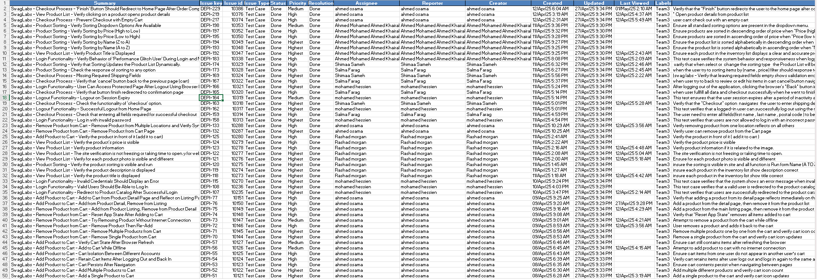
Test Cases

Slide 10
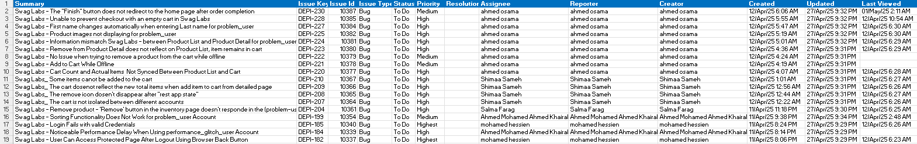
Bug Report

Slide 11
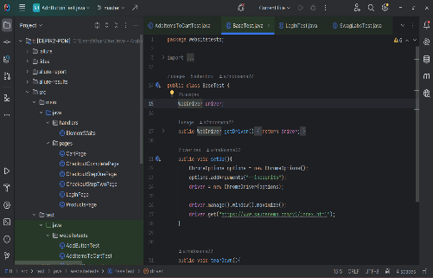
02
Automation Testing

Slide 12
Overview and Benefits
Automation testing is a process of executing test cases automatically using scripts, tools, and frameworks to validate the functionality, reliability, and performance of a software application. This approach is essential for repetitive, high-priority, and complex workflows that require precision and efficiency.

Slide 13
Key Objectives
1 . Reliability :
Ensure consistent results across test executions.
2. Efficiency :
Reduce manual efforts by automating repetitive tasks.
3. Coverage :
Increase test coverage for critical and complex scenarios.
4 . Scalability :
Allow for the addition of new test cases with minimal effort.

Slide 14
Benefits
1 . Faster Execution :
Automated tests run significantly faster than manual testing.
2. Improved Accuracy :
Reduces human errors in repetitive tasks.
3. Early Bug Detection :
Identifies defects early in the development lifecycle.
4 . Cost Efficiency:
Saves time and resources in the long run.
5 . Enhanced Reporting :
Provides detailed insights into test results with minimal manual effort.

Slide 15
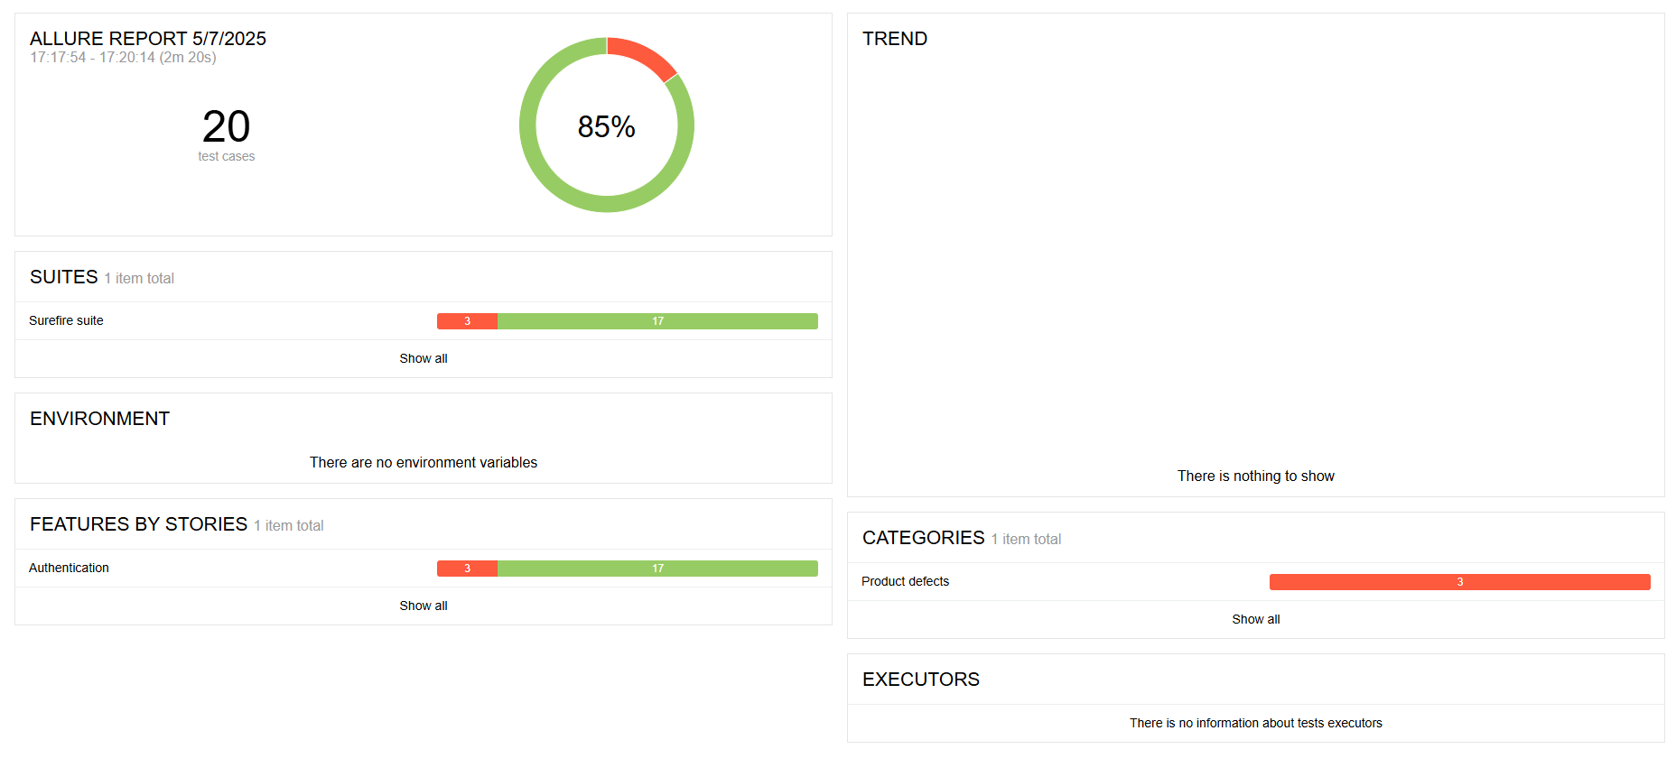
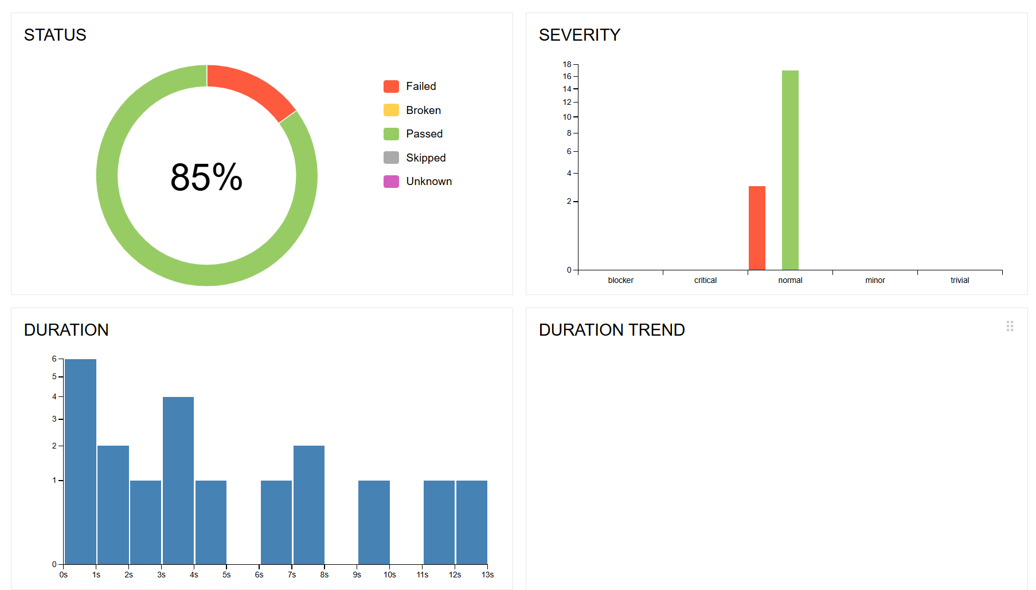
ALLURE Report

Slide 16
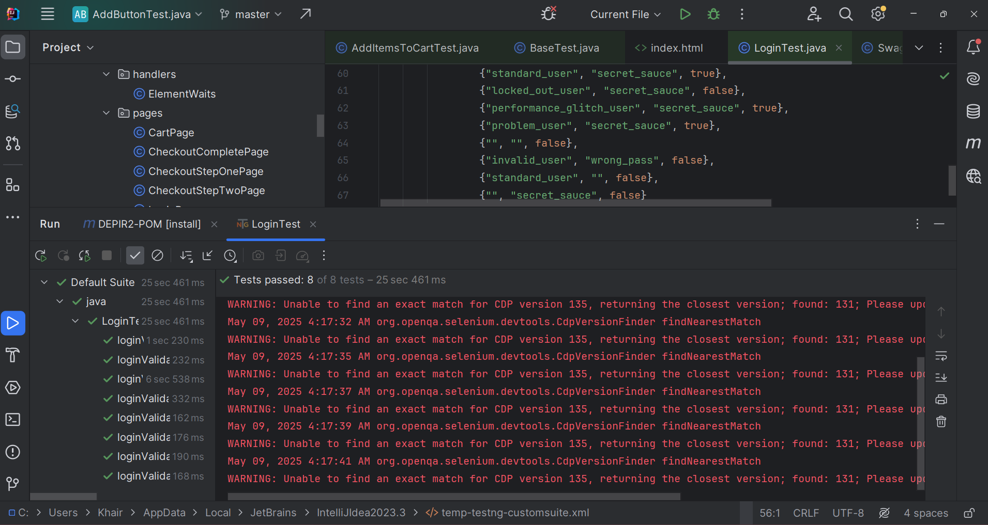
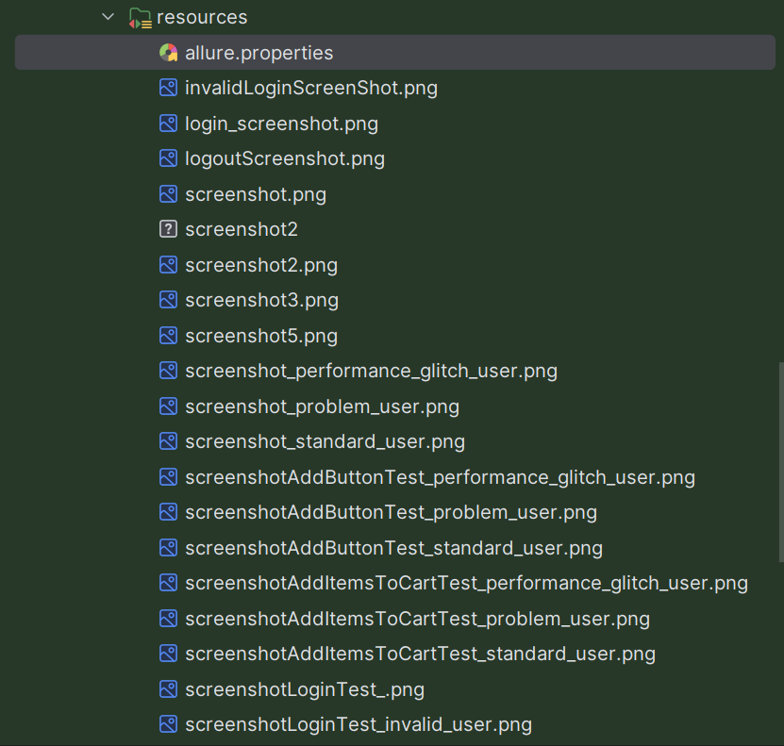
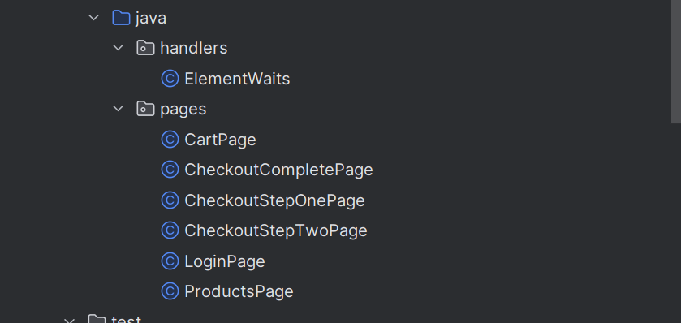
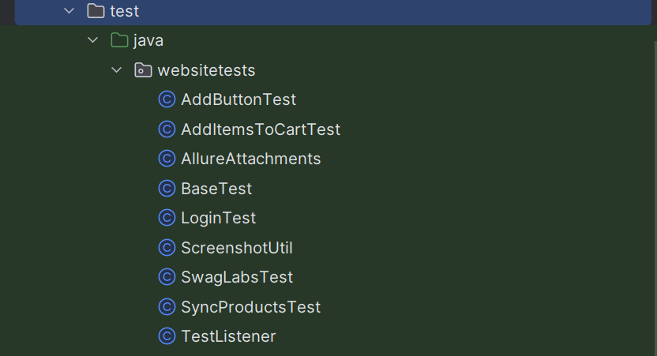
ScreenShots

Slide 17
Thank you!
Do you have any questions?
Thank you!

